Slide 1
Annual Interagency Accessibility Forum
Accessibility: A Foundation for Inclusion, Diversity, and Equity
October 12, 2021
Accessibility First: Creating a Native Mobile App for Veterans
Presenters: Martha Wilkes, Meli Manak, Bess Green

Slide 2
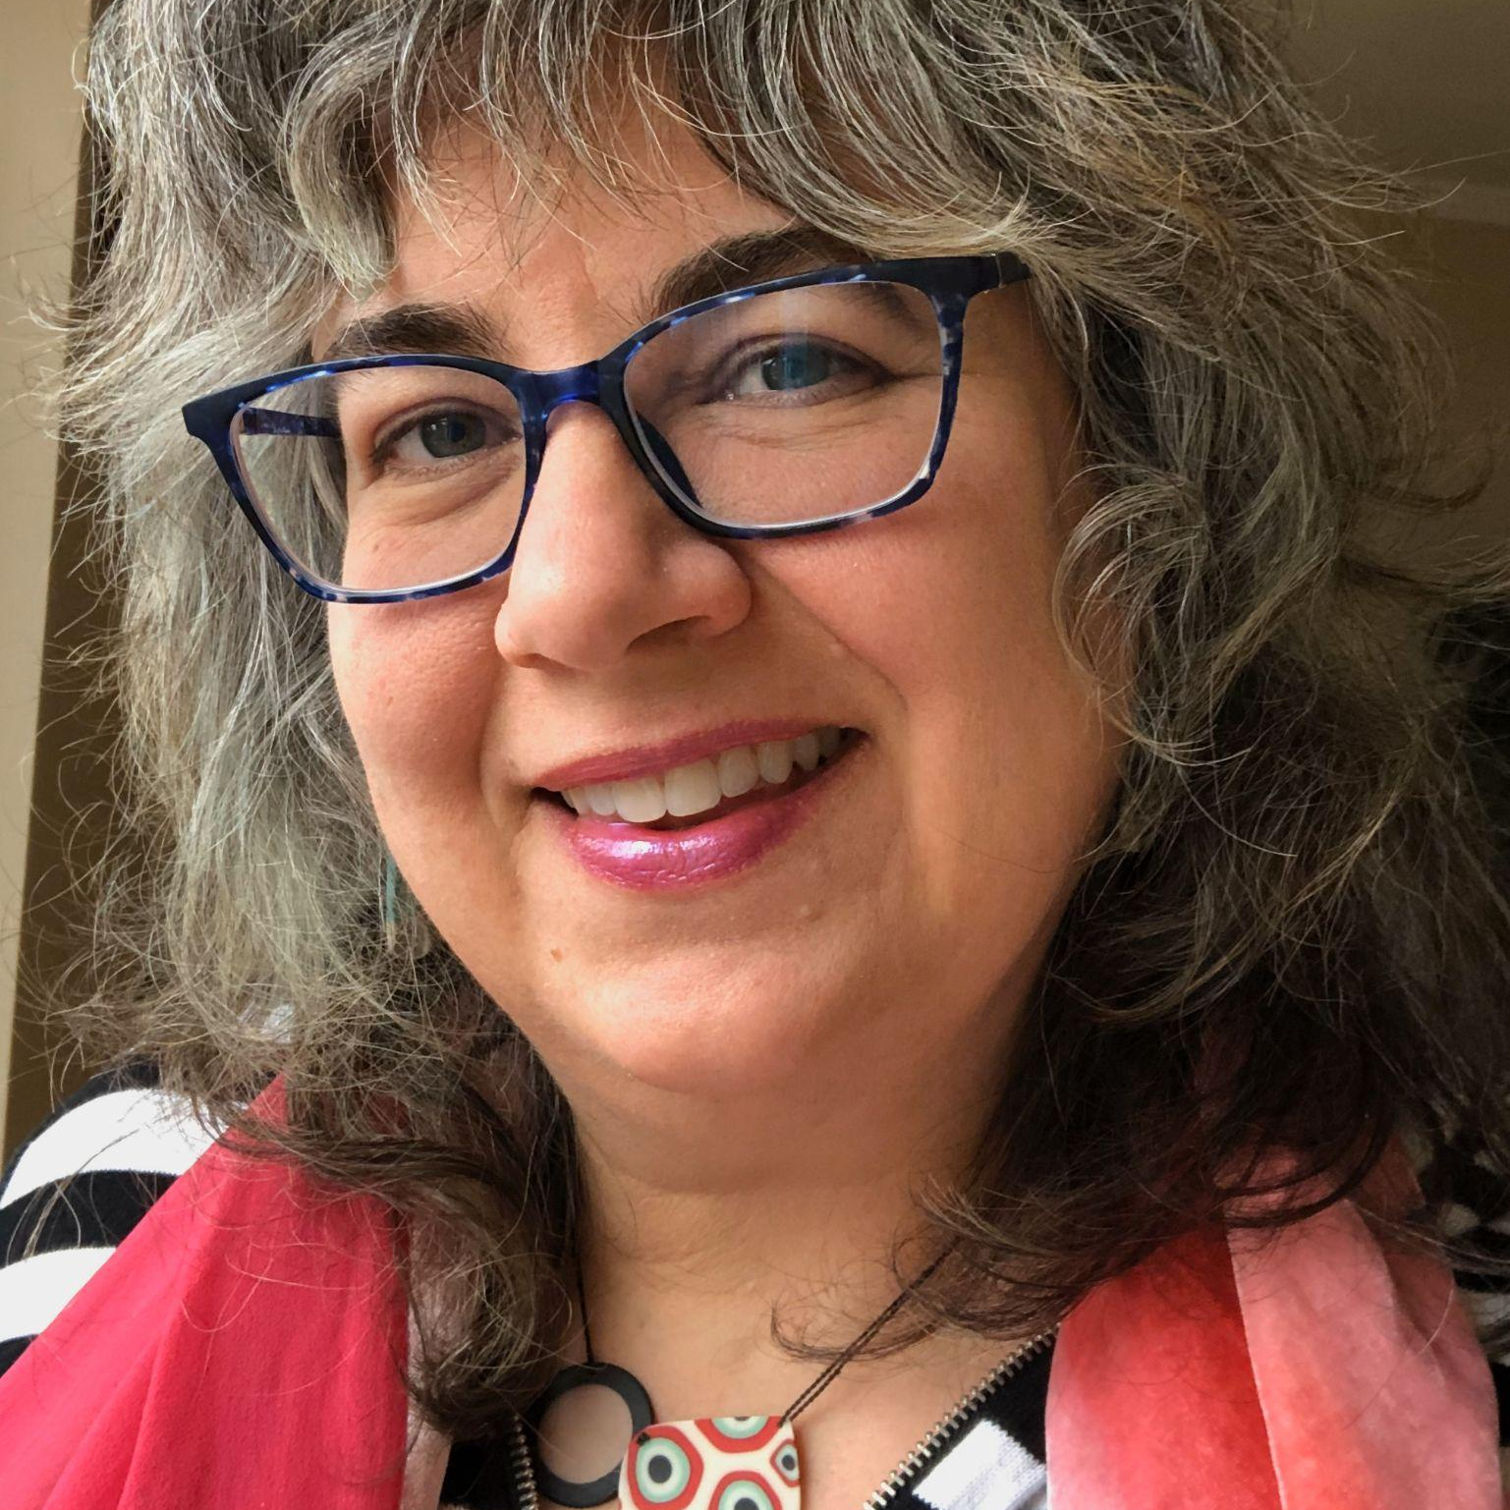
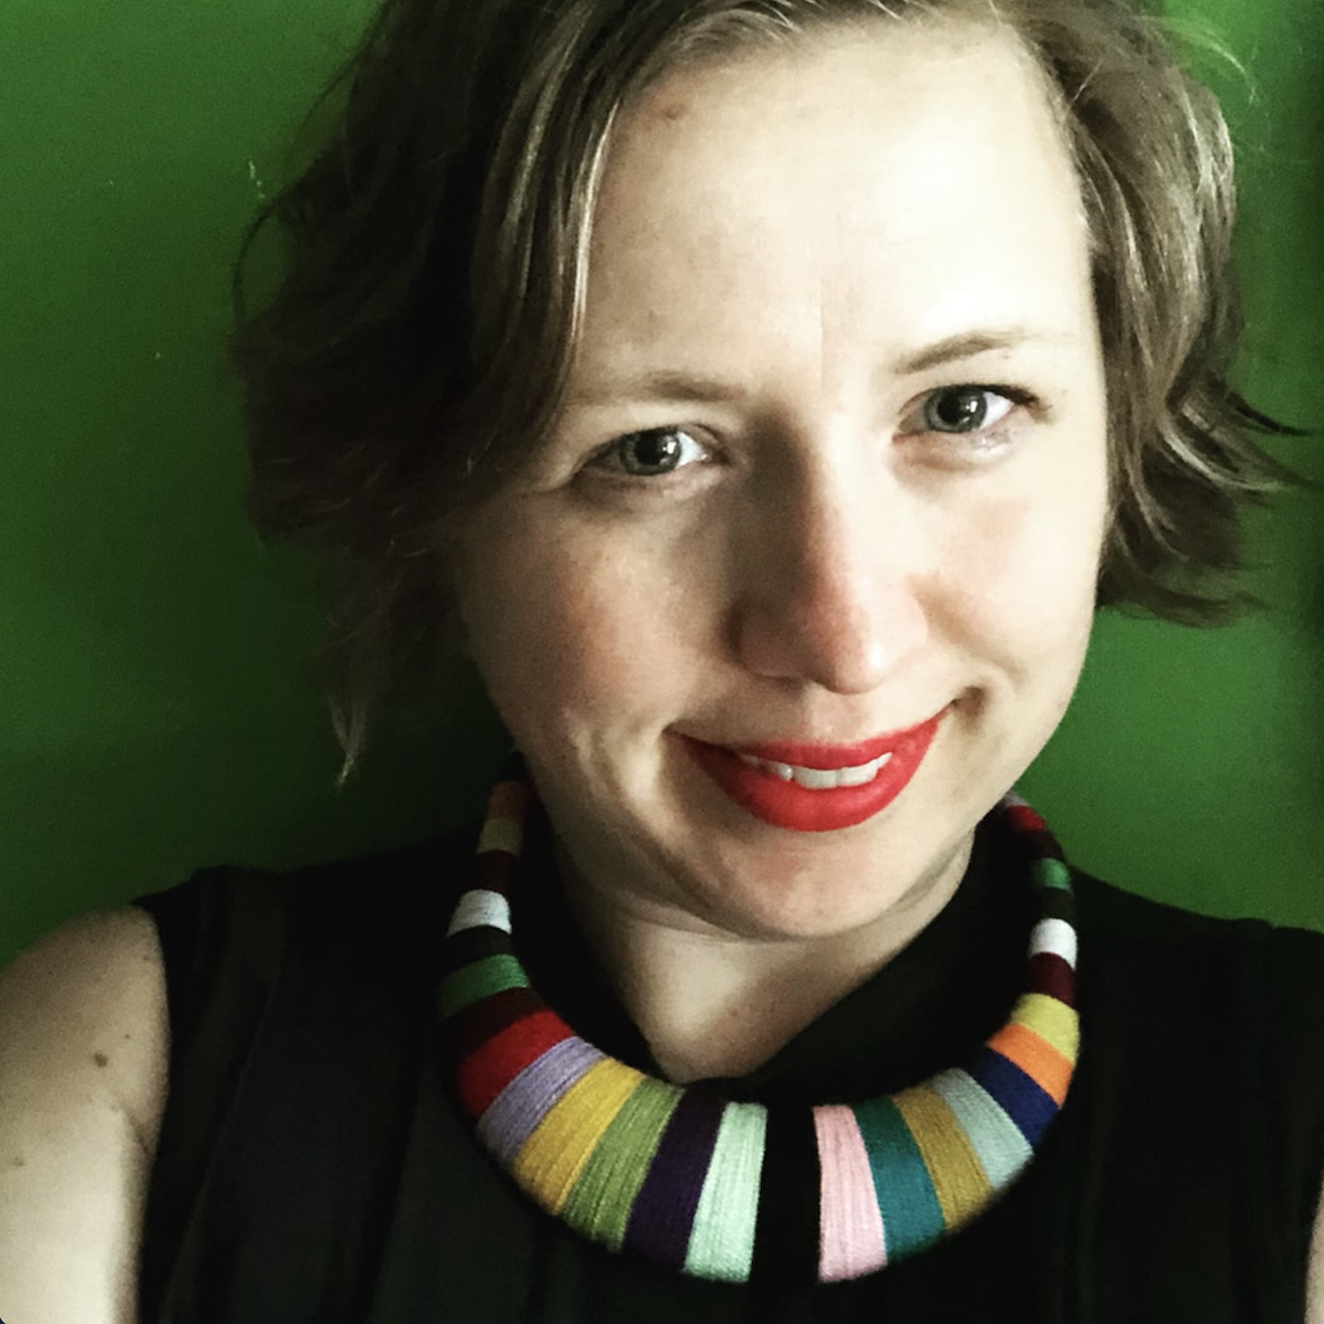

Welcome!
Martha Wilkes
Accessibility Strategist VA Office of the CTO
Meli Manak
Sr UX Designer, Mobile Accessibility Ad Hoc
Bess Green
Sr Digital Strategist Digital Foundry
Notes:
MARTHA
Welcome and intros
We’re going to talk about how VA’s new native mobile app took an Accessibility First approach
Share the milestones and decision points that changed the culture around accessibility on this team
Give you specific examples of how this team made it happen and hopefully inspire you to take an Accessibility First approach on your projects

Slide 3
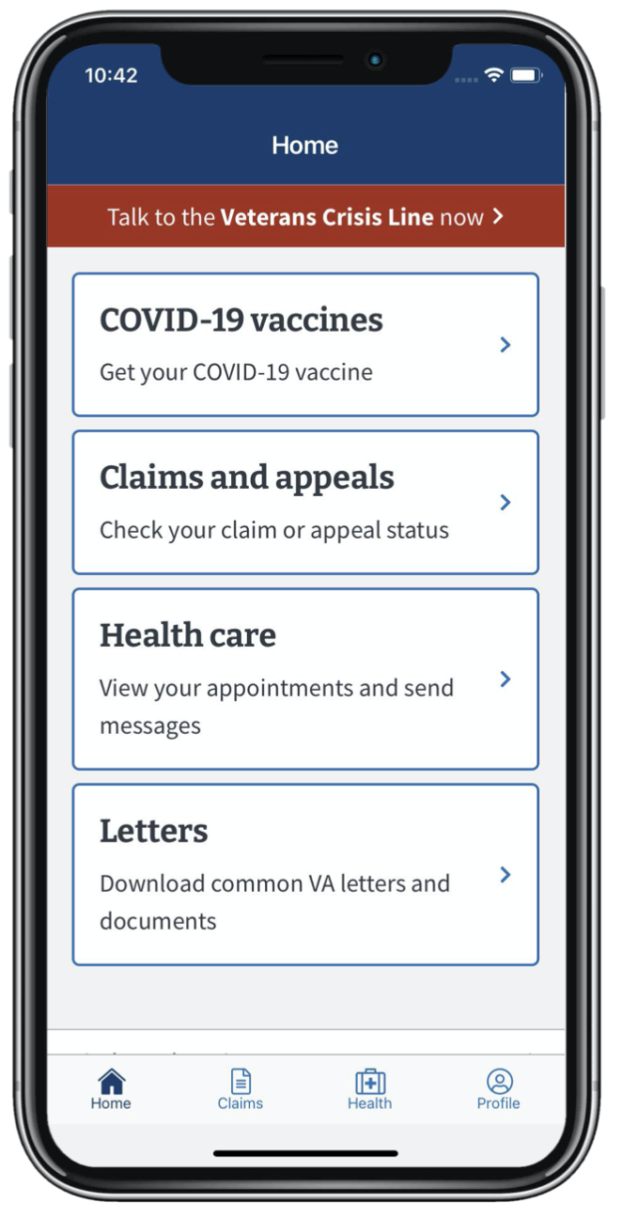
What is the VA Health and Benefits mobile app?
Created by the VA Office of the CTO, Veterans Benefits Administration, Veterans Health Administration Office of Connected Care
Contracting partners: Ad Hoc, Digital Foundry, Liberty IT Solutions
React Native mobile app that lets Veterans access quick transactions
VA Health & Benefits Mobile App
Notes:
MARTHA
VA Health and Benefits is a native mobile app for iOS and Android that helps Veterans who are already engaged with VA complete quick transactions across both health and benefits.
Written in React Native
Health care appointments, secure messages, downloading VA letters, viewing disability claim status progress
We will talk in detail about how we built in accessibility every day during our design and development process.

Slide 4
How did VA decide to be Accessibility First?
Because this was a native app, we knew we could set a high bar for accessibility
Web Content Accessibility Guidelines (WCAG) 2.0 compliance at a minimum per VA’s official standard
VA made it clear that we wanted to take an Accessibility First approach, because it’s so difficult to add in later
The team accepted VA’s challenge, and exceeded expectations
Notes:
MARTHA

Slide 5
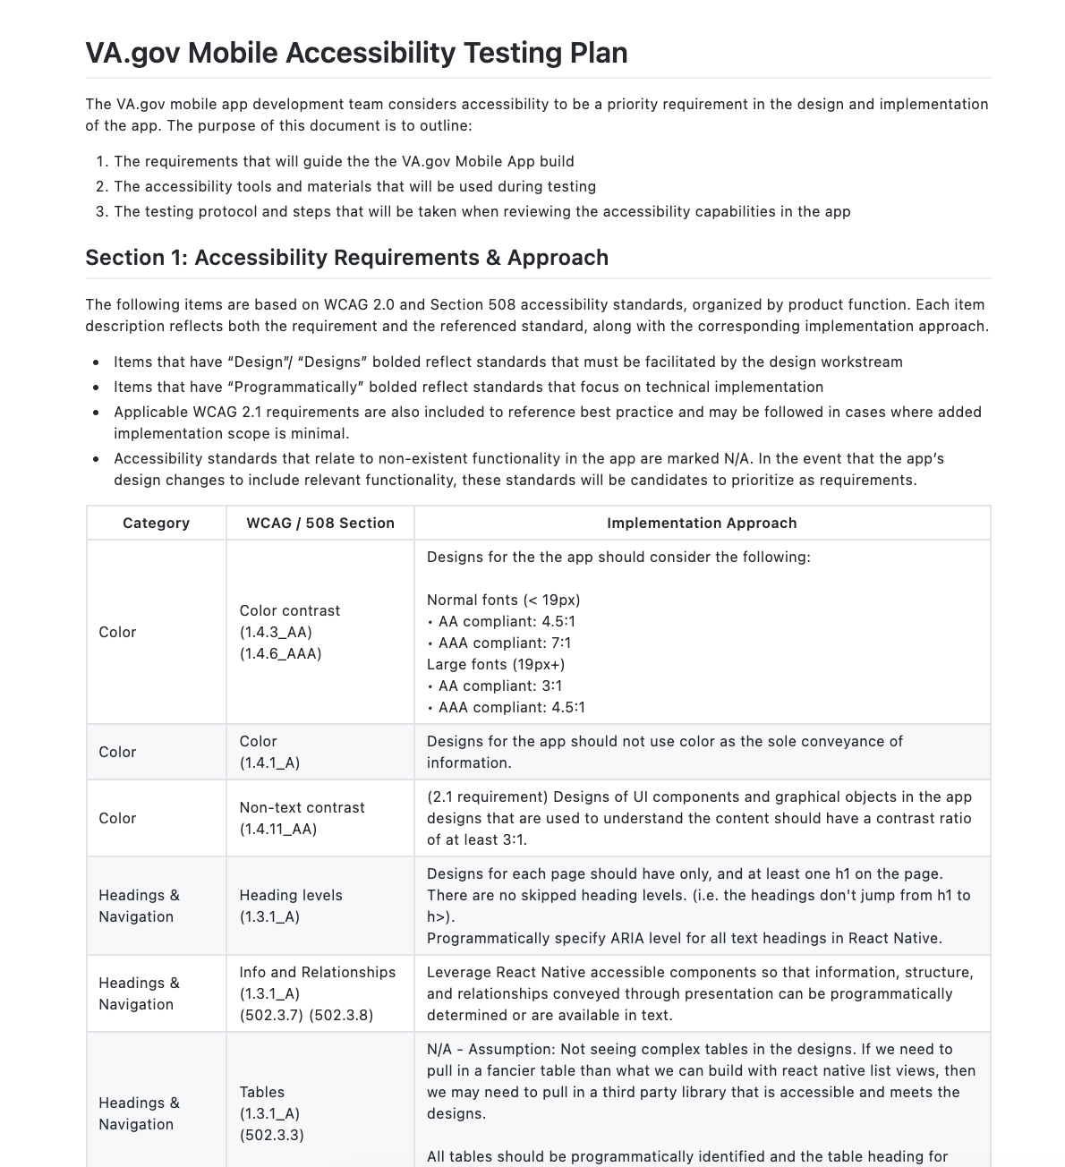
Our first Accessibility First moment
VA asked the team to include accessibility in their initial tech research
At the first official meeting I had with the development team, they presented the accessibility testing plan
Veterans deserve the best digital experiences, and that includes the best possible accessibility
Mobile Accessibility Test Plan
Notes:
MARTHA
In early tech investigations, VA asked the team to include accessibility in their initial tech research.
At the first official meeting I had with the development team, Bess presented the accessibility testing plan.
When Bess presented that accessibility testing plan, I was gobsmacked! Truly an Accessibility First moment.
I asked later asked how that happened. I was told by the PM “because I made you seem scary to the team before they met you.”
I am not scary! But I my colleagues and I do have high standards, we believe that Veterans deserve the best digital experiences, and that includes the best possible accessibility

Slide 6
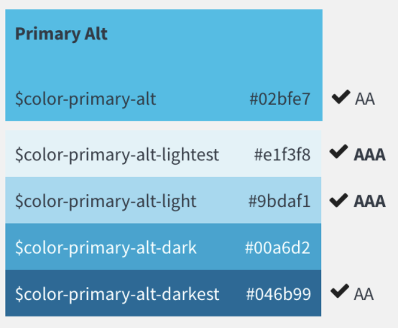
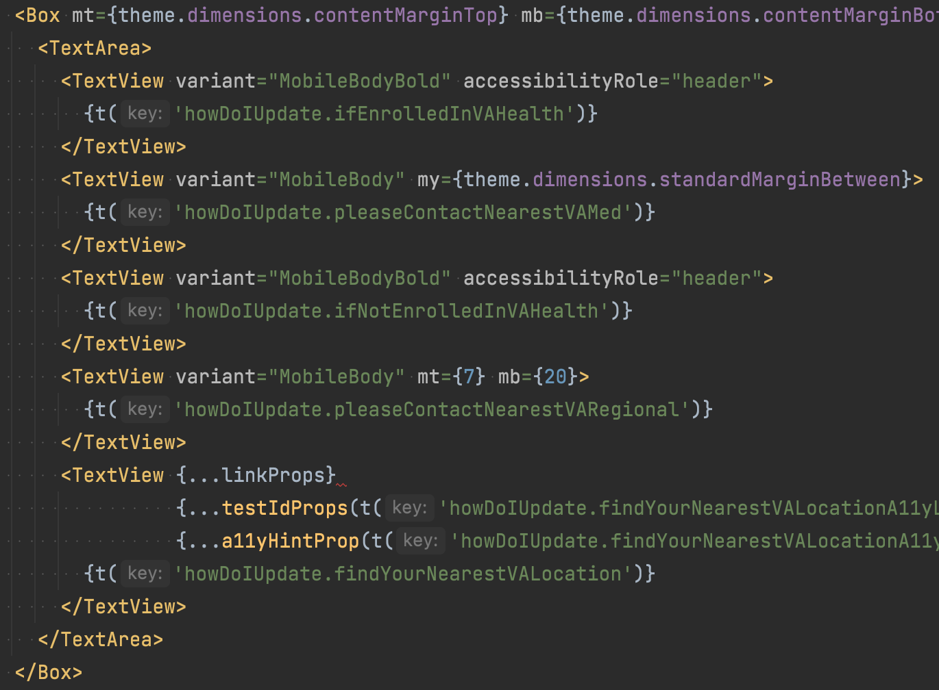
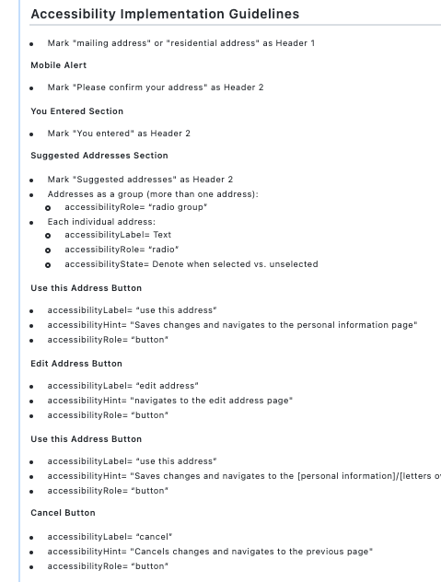
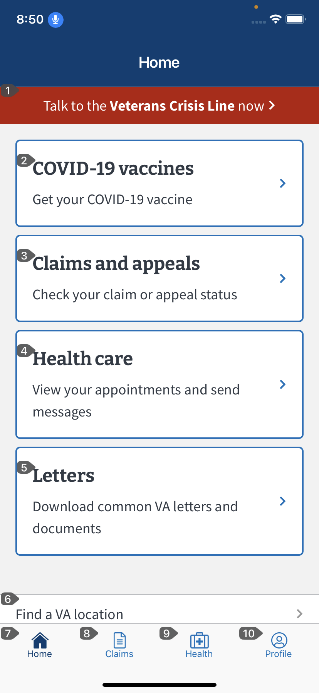
Every stage counts in an Accessibility First approach
Planning
Design & Definition
Development & QA
Color contrast requirements in design library
Example of accessibility in React Native
Mobile Accessibility Test Plan
Example of accessibility requirements in development backlog
Example of voice command QA
Notes:
BESS: Every stage counts when you take an Accessibility First approach
Planning: Mobile Accessibility Test Plan
Design and Definition: a11y requirements defined in the design library, then are brought into development backlog
Development: a11y specifications surfaced in React Native code, tested and verified in QA on various devices

Slide 7
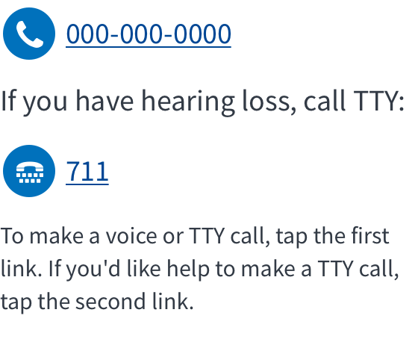
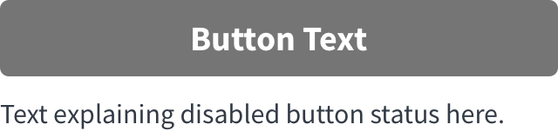
How was the design process Accessibility First?
Designed with accessibility in mind from the start
Based on existing VA design system with modifications for native mobile
Things we did:
Content takes the center stage
Generous font sizing
Go beyond guideline standards
Example 1: TTY click-to-call
Example 2: Disabled button
Notes:
Meli
Designed with accessibility in mind from the start.
Color contrast following 1:4.5:1 ratio between the foreground content and the background content. Unless The content is large. If the text is large enough to exceed 18 pt. font size or, a contrast ratio of 3:1 can exist.
Break up of content and white spaces, using accordions when needed
Improved form fields and Interaction flows
Tap targets being minimum of 44 by 44px, button sizes, etc
Based on the existing VA design system with modifications for native mobile.
Our design system is based on the web version of VA.gov Design System and U.S. Web Design System (USWDS) as well as use our react-native library which focuses on the mobile. We adopted a lot of our designs to be high-level mobile components that could be used for both iOS/android
We are also constantly refining beyond WCAG 2.0 and section 508 guidelines targeting 2.0 standards.
Note that the current WCAG guideline does not have mobile rules but that does not mean we can skip or ignore it.
Things we did:
Content takes center stage.
Our Design philosophy is to let the content itself take center stage - icons and graphic elements are not prioritized.
Content languages that eliminate language barriers or conflicts over the screen reader
Ensure content was understandable for those with cognitive disabilities. This means fewer blocks of text and more use of white space to reduce cognitive overloads
Generous font sizing.
Font sizing was on the generous side for maximum accessibility and ease of use for everyone (we have had Veterans of all ages comment on how easy it is to read)
We went with a minimum of 17pt font as body and up to 24pt for the header.
In fact in one of our research studies, “Big buttons with small words” was mentioned by a Veteran in a session.
Go beyond guideline standards. For example:
calling experience, using my prior knowledge calling via an inside mobile app is very difficult for a person with a hearing loss. As some apps do not have a callkit that allows the user to call outside of the app using their preferred method. We took one step forward by ensuring that the TTY option was there for those who use TTY with an external device by designing a component that also explains how to make calls using TTY if the user needed help with this step.
Disabled buttons are usually bad practice when used incorrectly. For example, the greyed-out button would not pass color contrast. WCAG does make an attempt to ensure that color isn’t the only thing that coveys its purpose. We could have easily left this alone but we ended up pushing it further into adding a hint text explaining why the button is disabled. This alone helps our users to fully understand why they cannot continue next to their interaction flows.

Slide 8
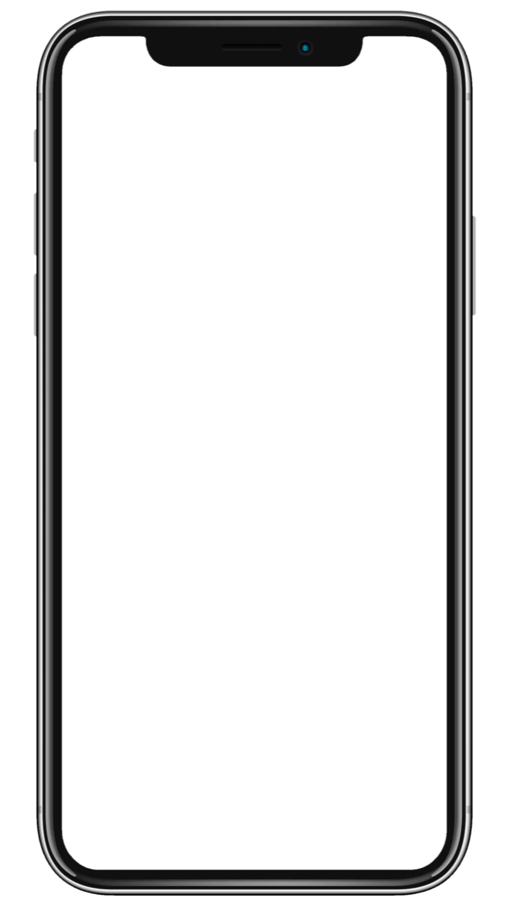
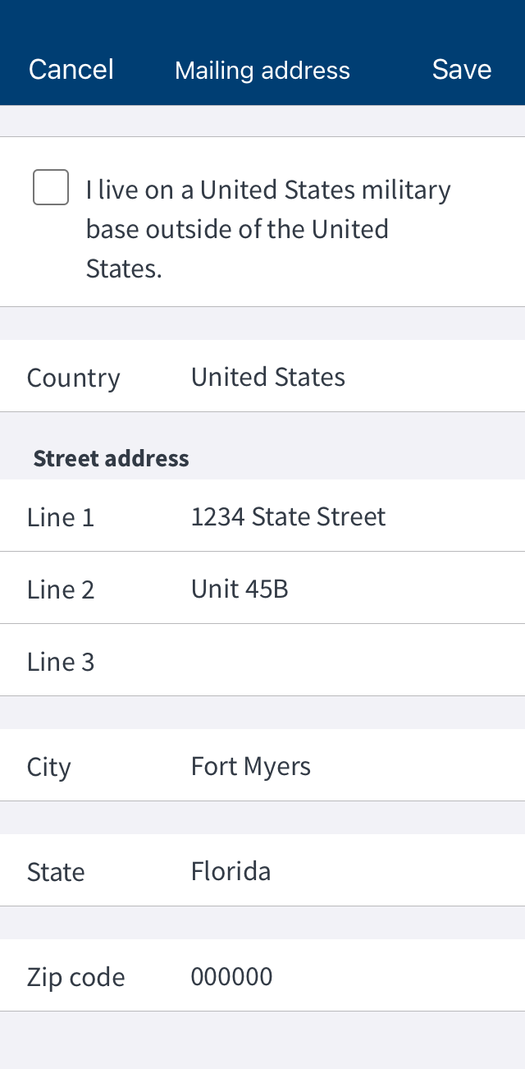
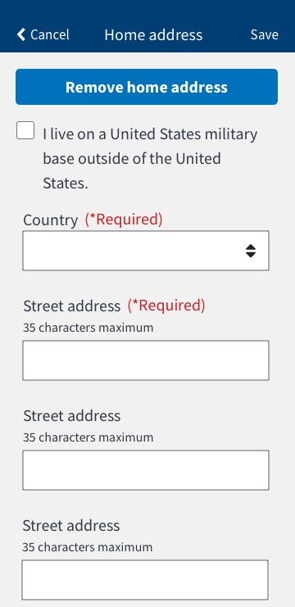
Case study: Form fields
Improvement candidate: Form UX/UI
Design audit surfaced accessibility & UX shortcomings
Original design didn’t respond well with larger text sizes
UX/UI wasn’t conducive for focused states & field errors
Updated to be compliant with better color contrast for low vision users
Used Google material design format, with helper text and field errors
Original design
Improved design
Notes:
MELI
Improvement candidate: Form UX/UI
Design audit surfaced accessibility & UX shortcomings
The original design for form fields didn’t respond well with larger text sizes when we enabled accessibility features like dynamic text
Additionally content language like line 1, etc would be confusing to users using screen readers.
UX/UI wasn’t conducive for focused states & field errors. We felt the focus stat removed the titled form that would be difficult to overcome if you had a cognitive disability.
Updated to be compliant with better color contrast for low vision users. For example
The white/grey background changed and the box outline made contrast easier to review forms. Additionally, we ensured the error and focus state outline be more evident to the user.
The form field can be enlarged with dynamic text.
Languages used within each form are improved and easier to understand.
We used Google material design format, with helper text and field errors as part of our inspiration additionally it had the affordance that could be applicable to both operating systems

Slide 9
How did we incorporate accessibility into development requirements?
Accessibility requirements for dev & QA
Defined at the feature-level
App-wide requirements
Feature requirements
Example of functional requirements from frontend backlog
Accessibility requirements
. Included, but not limited to:
Header definition
Announcing AccessibilityLabel, Role, Hint, State
Announcing sequence of item in list
Example of feature-specific accessibility requirements
from frontend backlog
Contrast & touch targets
On the COVID-19 appointment detail page, create an additional section with information about how to cancel the appointment. The following events are hard-coded:
Header: “To cancel this appointment, call…”
Description: “COVID-19 appointments can’t be…”
Display the following details if they’re returned from the API:
Facility name (ex: Cheyenne VA Medical Center)
If the API does not return this data, don’t display anything
Facility phone number with click-to-call
Text resizing
Mark “To cancel this appointment, call your VA medical center” as Header 3
Mark “[Facility name]” as Header 3
Phone number (link)
Title= Name of link, (e.g. 800-698-2411)
accessibilityHint= “Dials this number via your device’s call function”
accessibilityRole= “link”
Find your VA location (link)
Title= Find your VA location
accessibilityHint= “Takes you to the VA facility locator page”
accessibilityRole= “link”
Screen reader
Voice command
Bluetooth keyboard
Notes:
BESS
feature requirements: verifying feature requirements, including: UX/UI, API calls/data, loading, etc
Accessibility requirements: verifying accessibility requirements that are unique to the feature

Slide 10
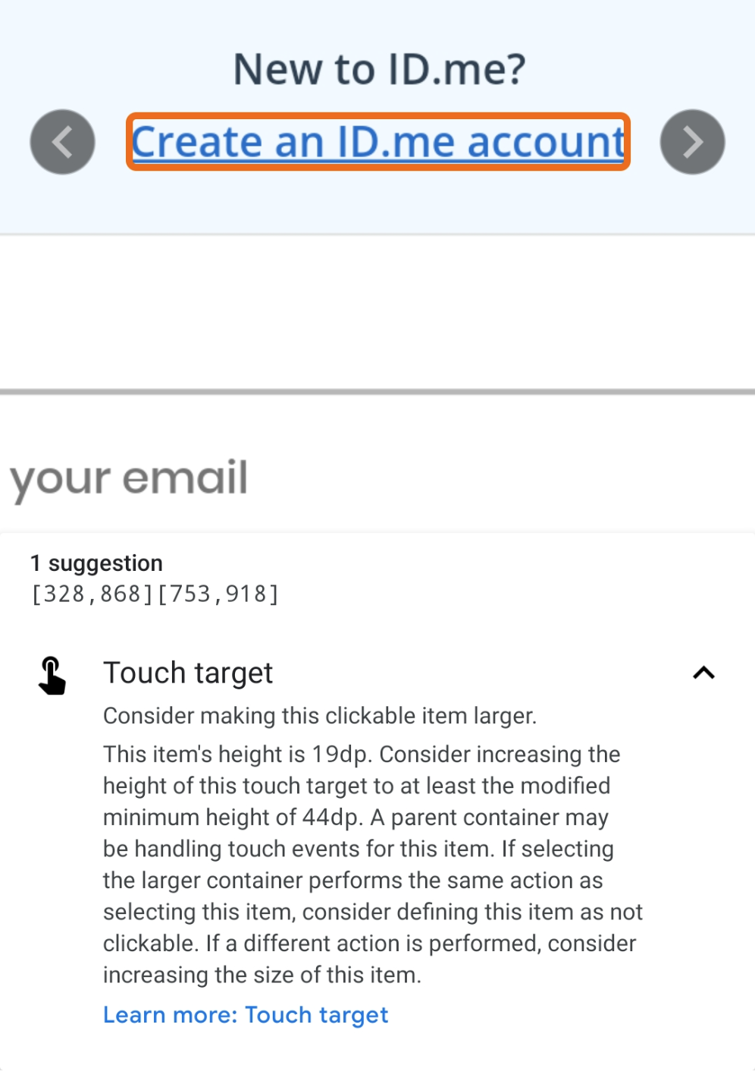
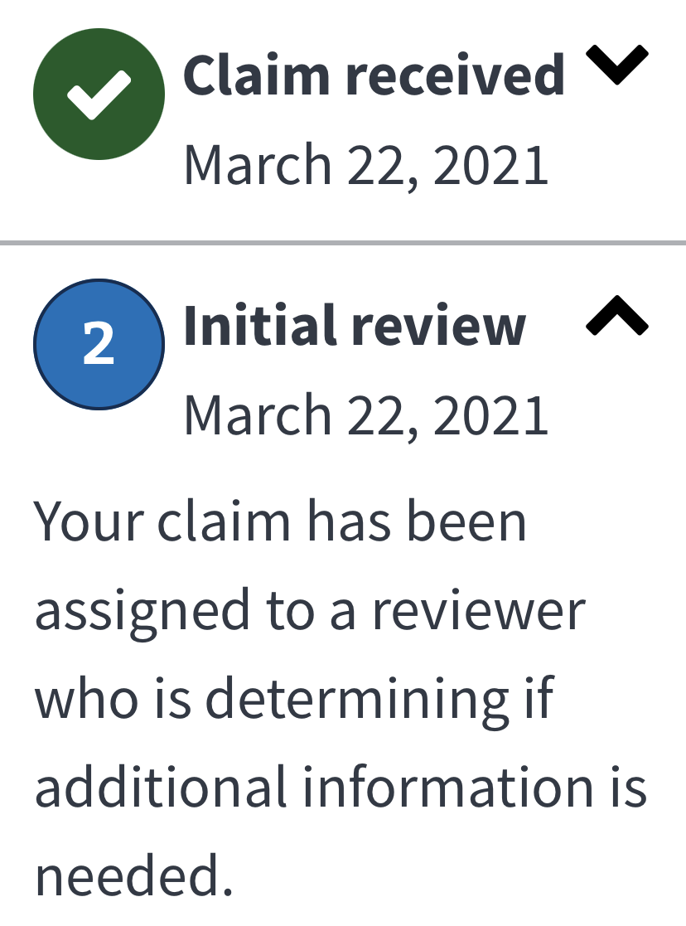
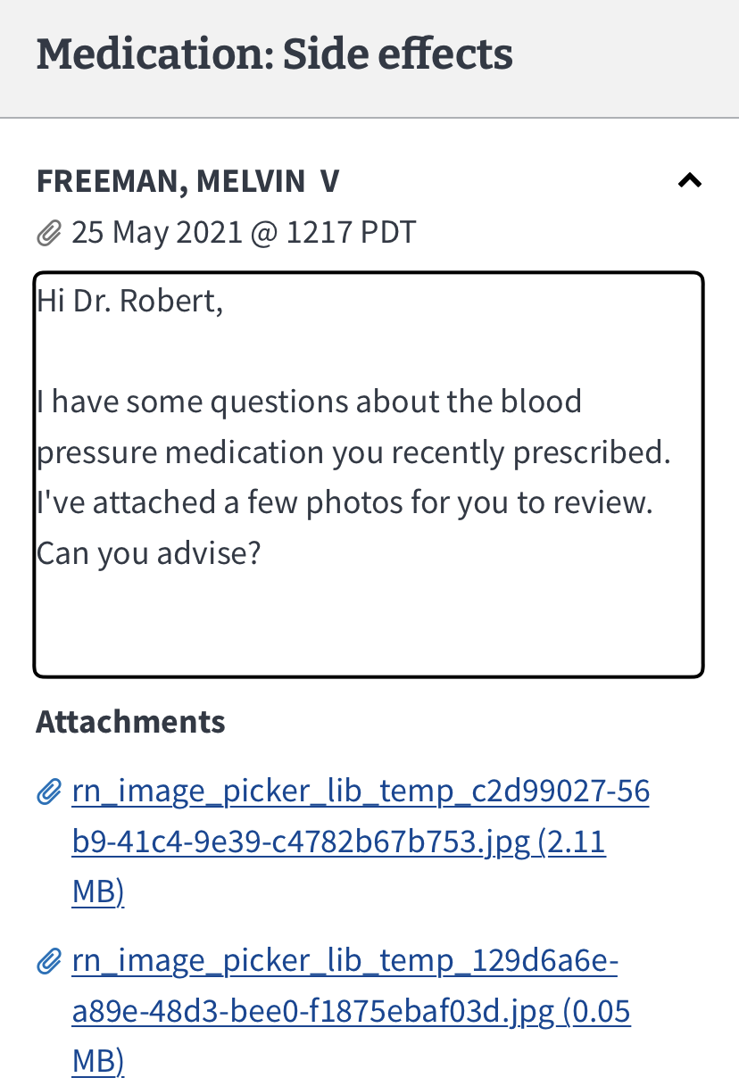
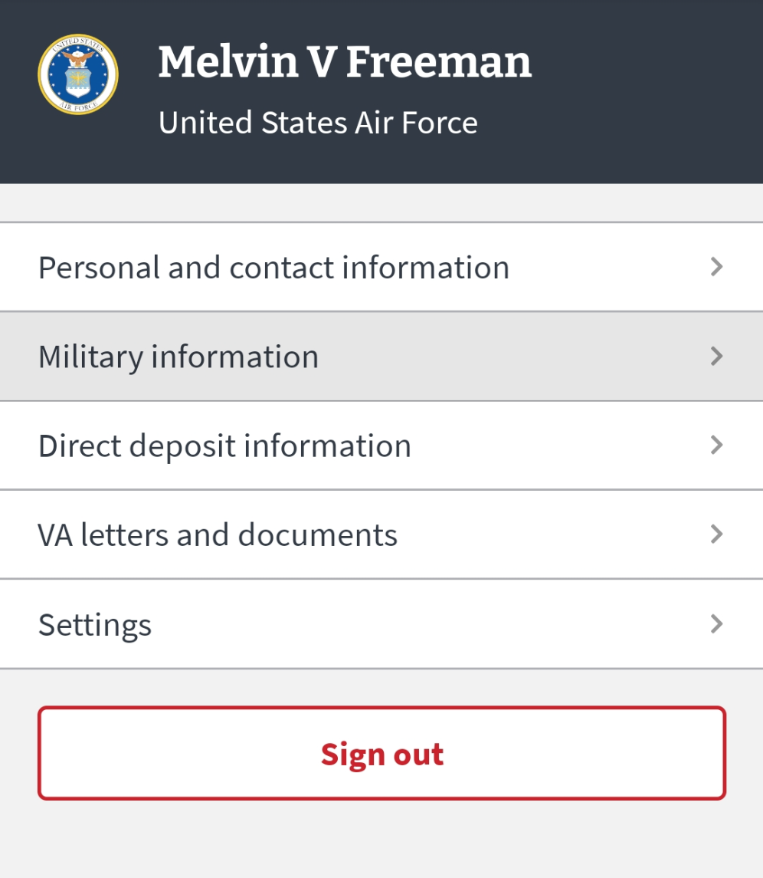
How did we test accessibility requirements?
Contrast & touch targets
QA tools:
Google Accessibility Scanner app
Google Accessibility scanner identifies issue with touch target size
Text
resizing
QA tools:
Text size control in the device Settings
Example of Claims detail page with larger text size enabled
Screen
reader
QA tools:
VoiceOver (iOS)
Talkback / Voice Assistant (Android)
Navigating with VoiceOver enabled, showing announced content in focus
Voice
command
QA tools:
Voice Control (iOS)
Voice Access (Android)
Navigating with Voice Control and “show numbers” enabled
Bluetooth keyboard
QA tools:
Bluetooth keyboard
Navigating with a bluetooth keyboard, with Military information in focus
Notes:
BESS
Contrast & touch targets - Verifying that color contrast & touch target size meets WCAG 2.0 standards
Text resizing - Verifying that text & app content may be resized without loss of functionality
Screen reader - verifying that app content is announced with a screen reader, like VoiceOver on iOS and Talkback/Voice Assistant on Android
Voice command - verifying that app content is navigable via voice command
Bluetooth keyboard - verifying that app content is navigable with an auxiliary keyboard

Slide 11
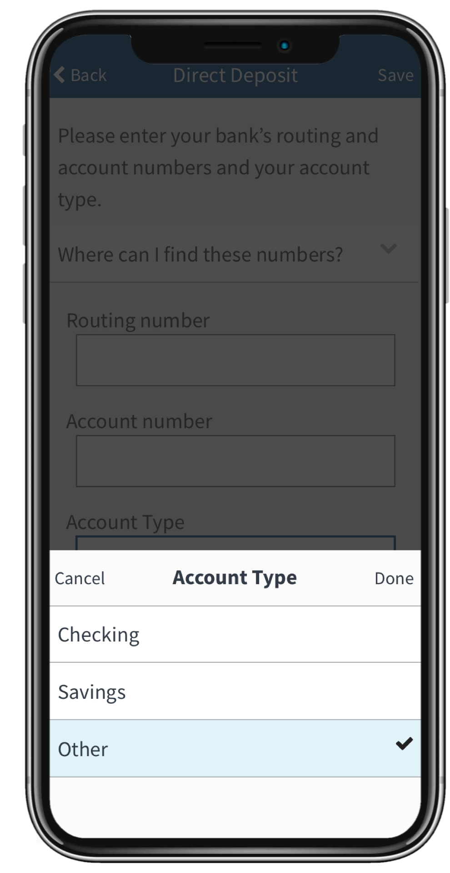
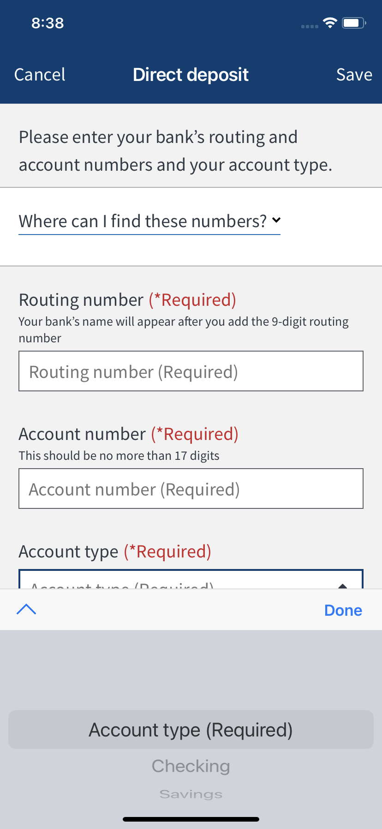
Case study: Picker list
Improvement candidate: Picker list
During QA, we discovered that the default picker could not be accessed with Voice Control, a key requirement for accessibility
This created a fractured experience for iOS users who rely on voice command for navigation
Team decided to design and build a custom picker list
Default picker Not accessible with Voice Control
Custom picker Accessible with Voice Control
Notes:
BESS
Example of recent QA that failed during testing was our Picker list that was not reading via screen reader and as a team we decided to make an executive decision that would impact our development chain as well give better accessibility experience to our veterans with vision disabilities.
During QA, it was discovered that our current picker component option list was not going to be feasible and it failed due to accessibility concerns such as:
Text in the dropdown list is smaller than non-dropdown text in the formfield
It also was unable to apply focused state to the dropdown box using voiceover.
As well field error state will not appear until user hits “Save” after finishing the forms.
Additionally, It addresses UX/UI inconsistencies on Android.
We could have left it alone or did a hack job but our mutual team decision was to go ahead and build a custom picker list that is not restricted to limitations of the react library with better UX and accessibility experience. You will see the final design on the right image. This is an example of the bank account type that user has to add.
This was example of a whole team decision making

Slide 12
How has the work been received so far?
“The work is extraordinary. Such a well thought out and executed 508 strategy. This group is two years ahead of us."
VA 508 Office
Notes:
MARTHA
When Meli and Bess presented the work to the VA 508 Office. They showed their detailed documentation about how accessibility was designed and tested in each feature.
VA folks were blown away.
“The work is extraordinary. Such a well thought out and executed 508 strategy. This group is two years ahead of us."
They were incredibly impressed with the team culture and how accessibility was just part of the development process every day.

Slide 13
What have we learned? Where can we improve?
As good as this team is, we are not perfect! Our first official VA 508 Office audit found 6 issues (a few originated from the back-end).
Remote testing with Test Flight and assistive tech was not possible
Planning for inclusive research with blind/low vision Veterans on site (when conditions allow)
Partnering with various blinded Veterans organizations to make sure their needs are met
Accessibility is a journey. We keep trying to get better.
Notes:
MARTHA
As good as this team is, we are not perfect! Our first official VA 508 Office audit found 6 issues.
Important that we’re not “fully accessible” yet!
The app hooks into back-end functionality and the app surfaces issues for other development teams
This app is part of a VA.gov eco system and we must coordinate with many other teams
Remote testing with Test Flight and assistive tech was not possible.
Inclusive research with blind/low vision Veterans on site (when conditions allow).
Partnering with various blinded Veterans organizations to make sure their needs are met
Accessibility is never DONE. It’s a journey and we keep trying to get better.
THANK YOU to the entire design and dev team who embraced this challenge and were the ones who really made it happen every day

Slide 14
We hope we’ve inspired you to be Accessibility First
On the “gov side”, set a high bar. Your teams will step up to the challenge and deliver.
During the design process, consider accessibility as a guiding principle for all design decisions. Everyone will benefit.
During the development process, treat accessibility as another QA requirement that is verified daily.
Thank you! Any questions?
Notes:
MARTHA

